Slide 1


Slide 2
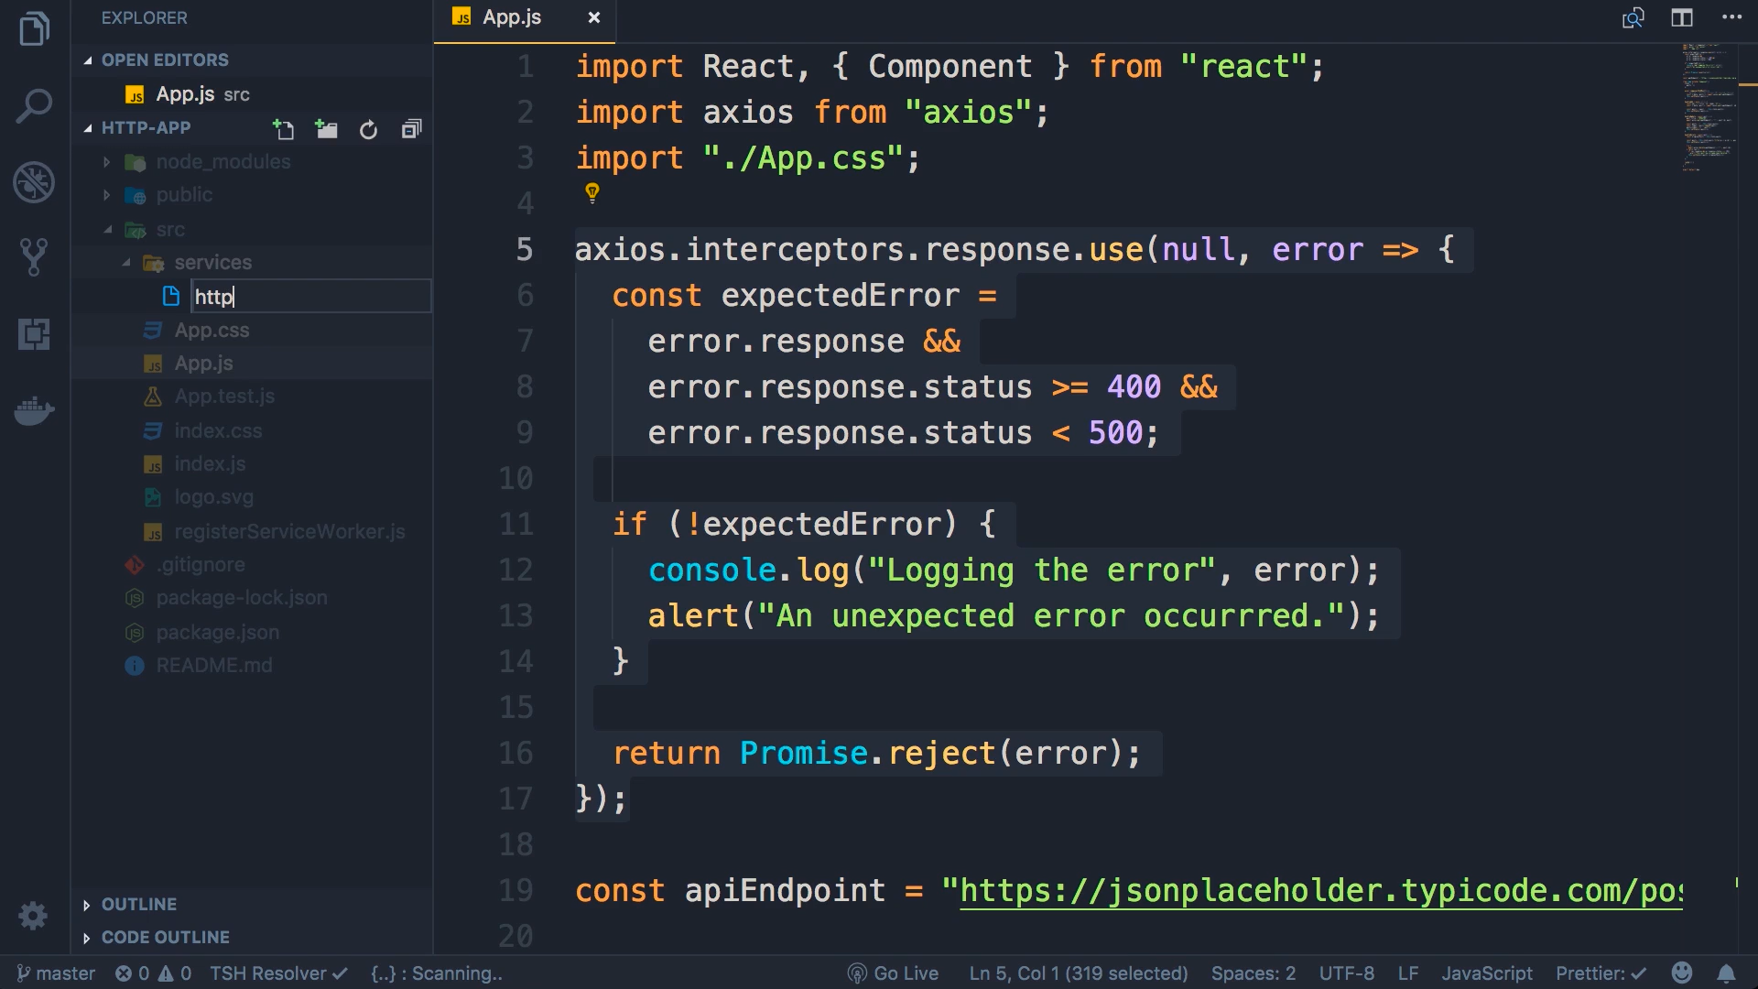
Lets write all this code in a separate module , so out app module looks simple. Create new folder services in src. Create httpService.js module in services

Slide 3
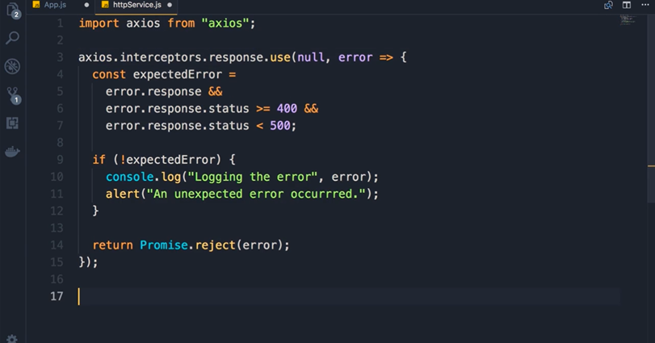

Slide 4
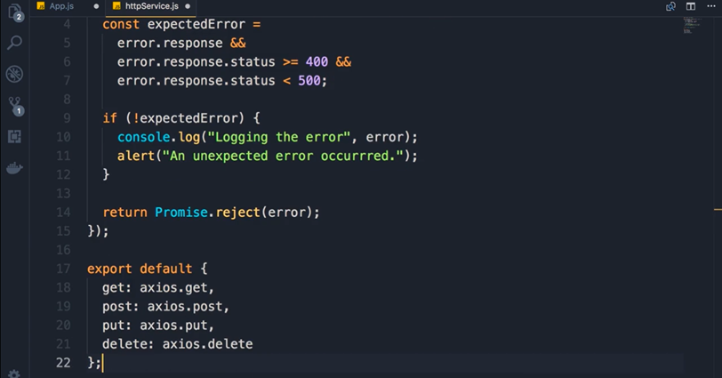

Slide 5
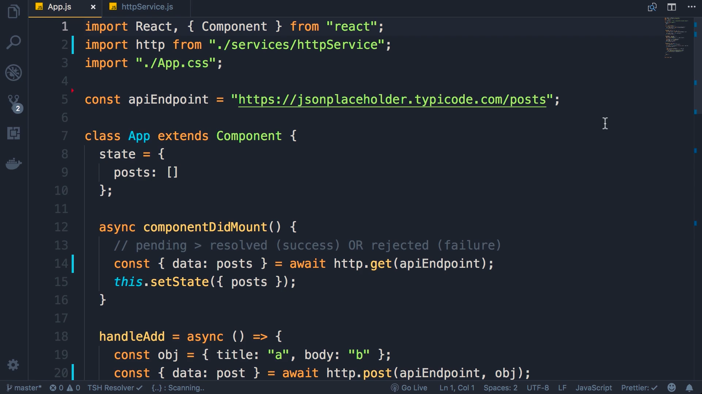
Where were you see axios rename it to http

